Slide 1

Real Estate Project Analysis
Visualizing property data for informed decision making

Slide 2





Presented By
1- Hesham Ahmed Suliman
2- Omar Abdelrahman Ali
3- Hoda Ahmed Mohamed
4- Samir Tarik Hassan
5- Sherouk Mahmoud Abdelnaby

Slide 3
Introduction and Agenda

Slide 4

Agenda
Project Overview
Project Objectives
Project Scope
Analysis and Insights
Conclusion

Slide 5
Project Overview

Slide 6

Project Overview
The Egyptian real estate market is dynamic and diverse, offering a wide range of property types from studios to luxury villas. This project focuses on the development of an interactive Power BI Dashboard to analyze current market data.
By utilizing a structured dataset containing critical property attributes—such as price, size (sqm), bedroom count, and payment methods—this project aims to provide stakeholders with actionable insights into pricing trends, inventory availability, and value-for-money assessments across different property categories. The dashboard will transform raw listing data into visual intelligence to assist investors, buyers, and developers in making informed decisions.

Slide 7

2. Project Objectives
The primary objective of this project is to visualize the real estate landscape in Egypt to answer key business questions. Specifically, the project aims to:
1- Analyze Pricing Trends: Determine the average Price and Price Per Meter across various property types (e.g., Villas vs. Studios).
2- Assess Payment Preferences: Evaluate the distribution of payment methods (Cash vs. Installment) and analyze the financial barrier to entry via Down Payment and Estimated Down Payment metrics.
3- Correlate Size and Value: Investigate the relationship between property size (Size by Meter) and total price to identify value outliers.
4- Monitor Inventory Status: Visualize the ratio of properties that are Ready to Move versus those Under Construction.
5- Bedroom/Bathroom Distribution: Segment properties based on the number of bedrooms and bathrooms to understand current market supply.

Slide 8
3. Project Scope
The scope defines the boundaries of this analysis and the specific data points that will be utilized.
Data Analysis: The project is limited to the analysis of the provided dataset columns:
Financials: Price, Down Payment - EGP, Estimated Down Payment - EGP, Price Per Meter.
Property Attributes: Type (Villa, Studio, etc.), Size by Meter, No of Bedrooms, No of Bathrooms.
Status & Transaction: Available or Under construction, Payment Method.
Visualization: Creation of a Power BI dashboard including:
Comparative analysis charts (Bar charts for property types).
Geography: The analysis is focused on the Egyptian market context provided in the dataset.

Slide 9
Analysis and Insights

Slide 10
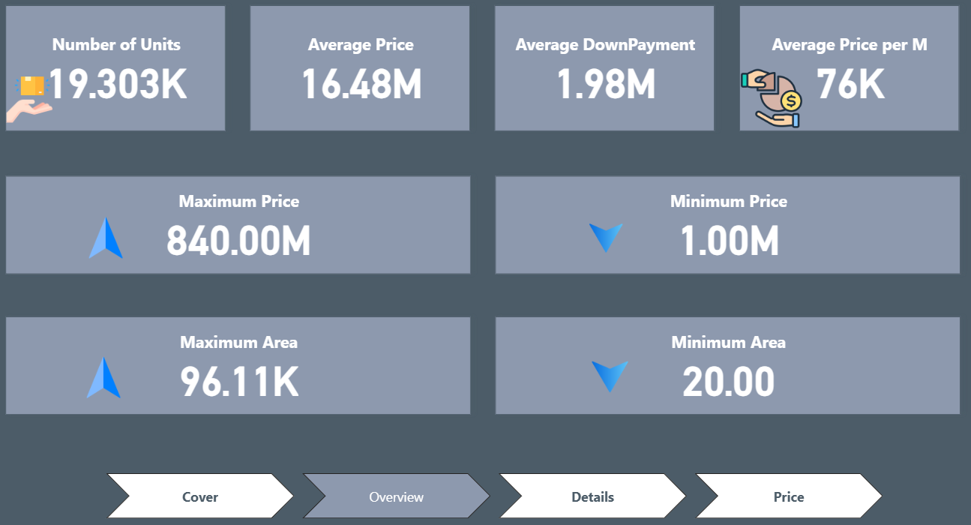
Overview

Slide 11
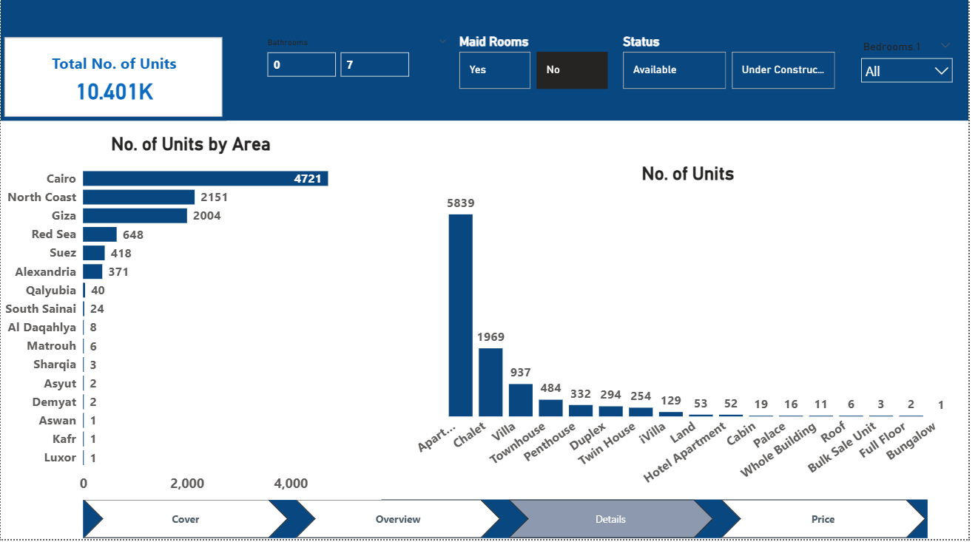
Details

Slide 12
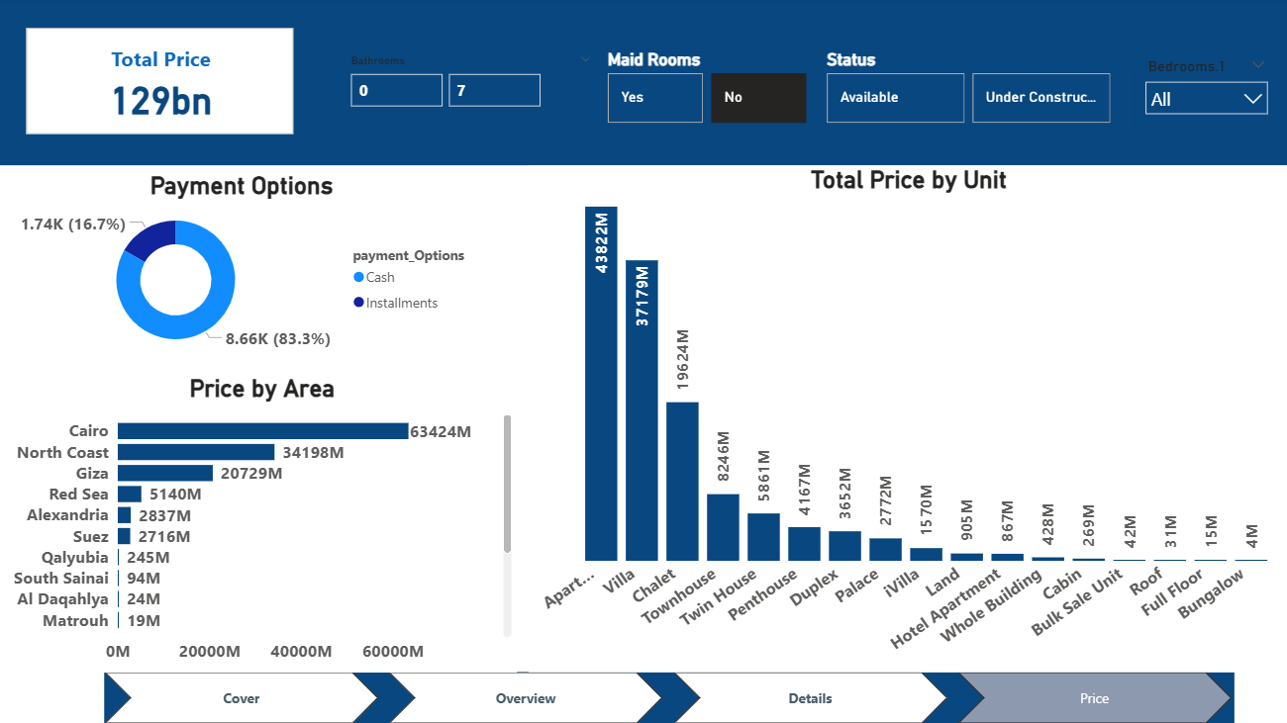
Price

Slide 13
Insights

Slide 14

Market Overview
Dataset includes 19.3K units, covering a wide range of property types and price levels.
Average unit price: 16.48M, with prices ranging from 1M to 840M, reflecting both mid-range and luxury segments.
Average price per sqm: 76K, positioning the market in a high-value bracket.

Slide 15
Property Size
Areas range from 20 sqm to 96.1K sqm, indicating a mix of compact units, villas, and large land offerings.

Slide 16
Geographic Distribution
Cairo leads with 4721 units, followed by North Coast (2151) and Giza (2004).
Minimal supply in cities like Luxor, Aswan, and Sharqia, showing low development activity.

Slide 17
Property Types
Apartments dominate with 5839 units.
Strong presence of chalets, villas, and townhouses.
Luxury categories (palaces, full floors, bungalows) appear in very limited quantities.

Slide 18
Key Observations
High reliance on installment-based payments, given the average 1.98M down payment.
Activity is concentrated in major urban and coastal areas.
Market shows strong diversity across price, size, and property type.

Slide 19
Conclusion
This dashboard serves as a vital tool for navigating the current Egyptian real estate market. By transforming raw listing data into clear visual insights, stakeholders can now easily identify pricing anomalies, assess value-for-money across different property types, and understand payment plan availability.
While this analysis focuses on current market snapshots, the foundational data structure established here allows for future scalability—such as incorporating historical price tracking or predictive modeling—to further enhance decision-making confidence for investors and buyers alike.

Slide 20
Thanks

